Slide 1

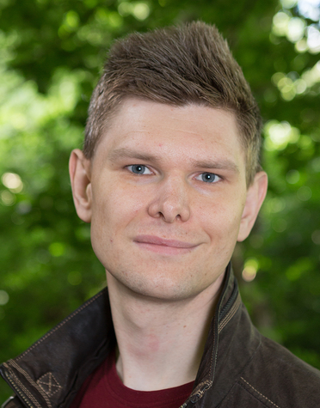

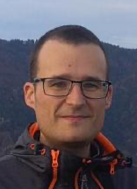
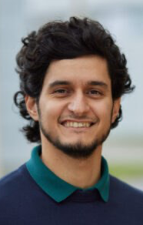


Team
Peter Willendrup DTU / ESS DMSC
Mads Bertelsen ESS DMSC
Gregory S Tucker ESS DMSC
Emmanuel Farhi Synchrotron SOLEIL
Tobias Weber Institut Laue-Langevin
José Robledo FZ Jülich / IAS / JSC
Team Mentors
Jan-Oliver Mirus FZ Jülich / IAS / JSC
Ilya Zhukov FZ Jülich / IAS / JSC

Slide 2
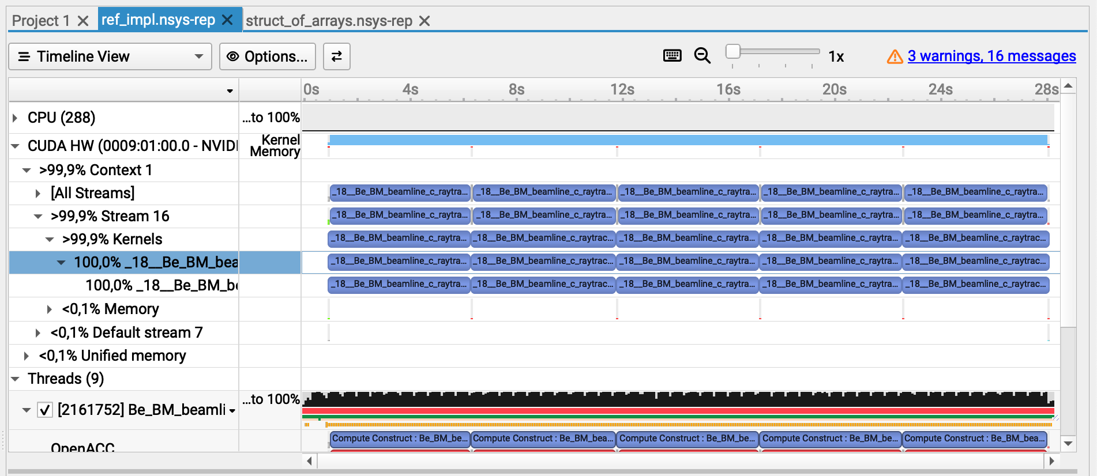
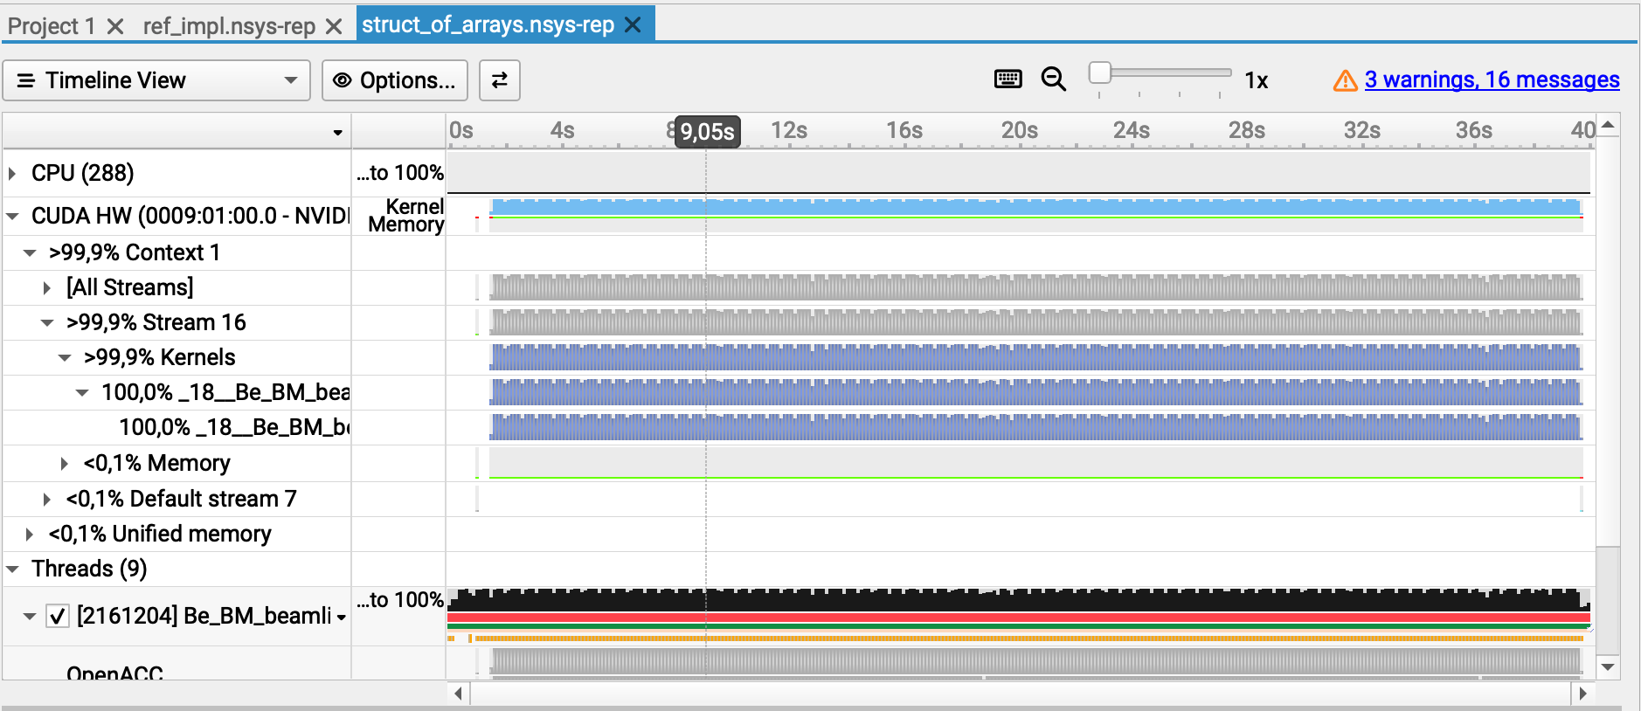
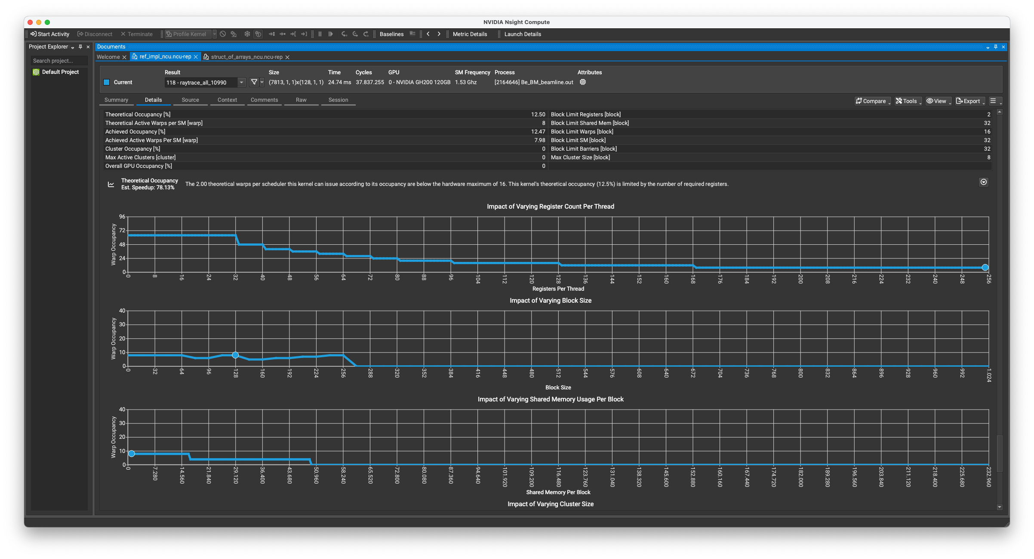
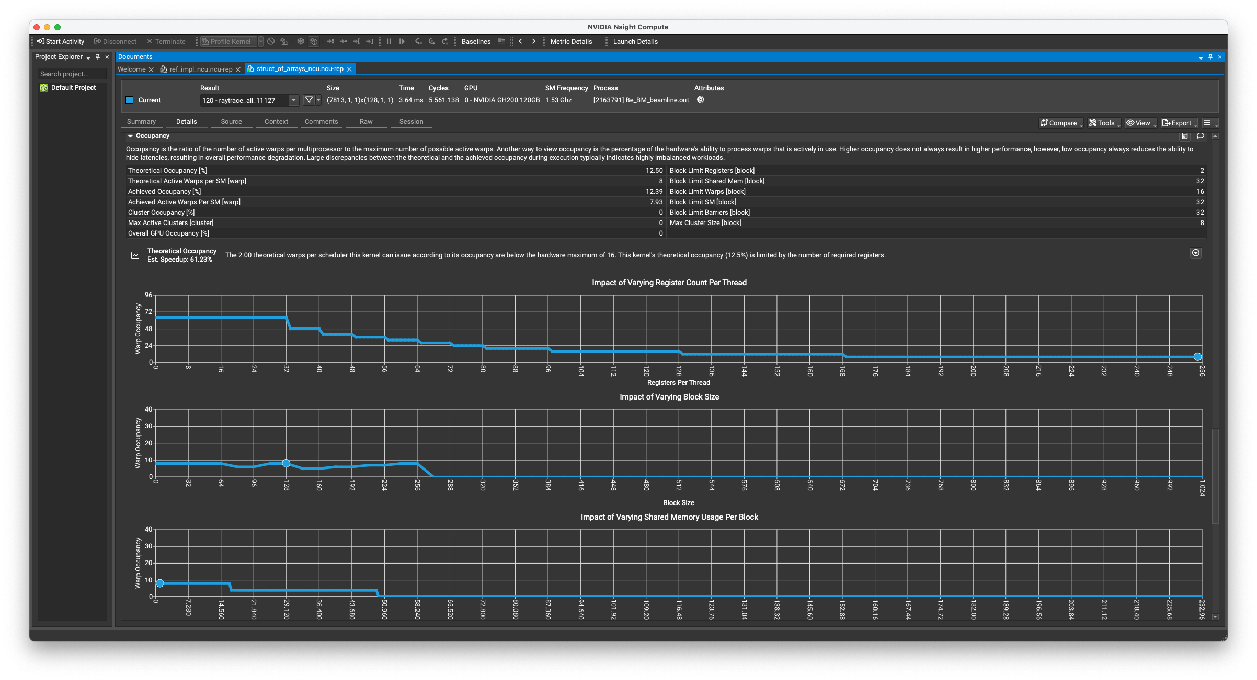
After restructure cogen “arrays of struct” -> “struct with arrays”…
Profiler Output
“Reference” / monolithic kernel - 1e10 / 5 launches x2e9
“Struct of arrays” / monolithic kernel - 1e10 / 10k launches x1e6
Main workforce: Mads & Emmanuel
Needs more work / pragma review, slightly slower for now

Slide 3
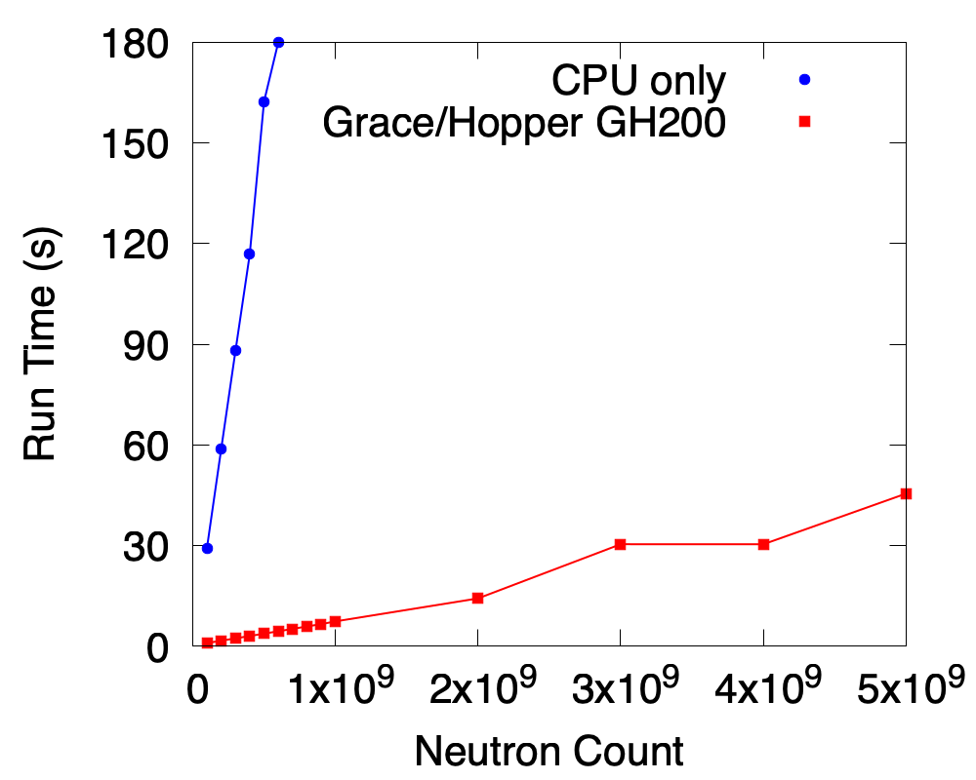
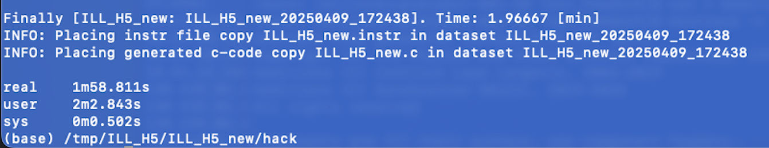
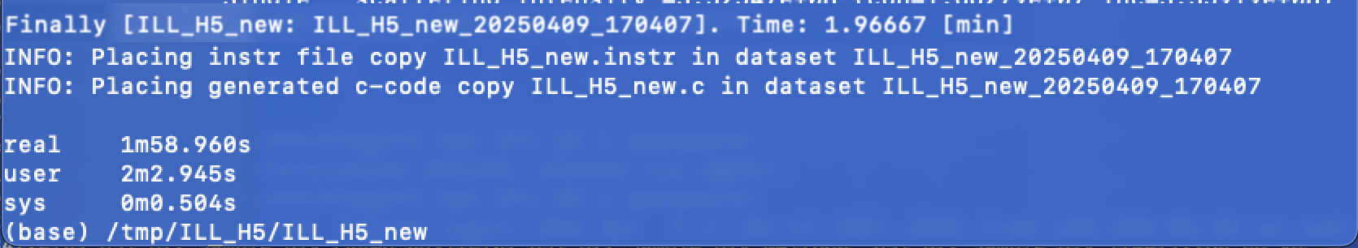
Other news
Other progress
Tobias: more work on specific instr/problem TAS resolution, fully functional and good performance
José with Greg: work on understanding and readability of ‘sorting algorithm’ for FUNNEL mode. No measurable diff. yet.
Peter: solution to avoid dev->host copy. No measurable difference

Slide 4
Goals
Goals for today:
More profiling / tuning of new structure layout
Funnel-implementation for the new structure layout
Benchmarking / critical look at ‘general vectorisation’ of CPU side code
Closer look at specific hkl_search function in Single_crystal case
Experiment with sort algorithm / try with thrust solution?

Slide 5
Problems and Solutions
Success restructuring code quickly but no speedup in sight
Actual issue hiding somewhere else?

